Slide 1
Distributed Computer Systems
CT024-3-3-DCOMS and VE
Testing

Slide 2
TOPIC LEARNING OUTCOMES
At the end of this topic, you should be able to:
1. Understand what is testing?
2. Understand the principles of testing
3. Various types of testing

Slide 3
Contents & Structure
Why is Testing necessary
What is Testing
General Testing Principles
Fundamental Test Process
The Psychology of Testing
Codes of Ethics

Slide 4
Recap From Last Lesson
What is serialization?
How is it important in distributed applications?

Slide 5
Common Definitions
Error (Mistake): A human action that produces an incorrect result
Defect (Fault / Bug): A flaw in a component or system that can cause the component or system to fail to perform its required function
Failure: Deviation of the component or system from its expected delivery, service or result
Reliability: The ability of the software product to perform its required functions under stated conditions for a specified period of time, or for a specified number of operations
Notes:
Error: refers to difference between Actual Output and Expected Output. Errors occur because we are not perfect and, even if we are, we are working under constraints such as delivery deadlines.
Fault: is a condition that causes the software to fail to perform its required function. A fault, if encountered, may cause a failure, which is a deviation of the software from its expected delivery or service.

Slide 6
Software Systems Context
Testing has become critical because:
Business functionalities / requirements are becoming complex
Timelines to manage change in a competitive business environment are becoming shorter
Legal / Regulatory framework is becoming more stringent to comply with
Greater volumes and loads are being handled by IT systems due to widespread use of applications
The Internet has magnified the possibilities for use / misuse
Humans are not perfect and so errors are likely to occur

Slide 7
Software Systems Context (CONTD.)
Complex Business functionalities : E.g., Incorrect programme of Interest calculation in a Banking Software programmed incorrectly
Person - A person may receive lesser interest resulting in loss of money
Bank - Bank earns more profit but bank losses credibility
Malfunction of an automobile software : E.g., Digital speedometer system of a car
Person - Misleads driver and leads to accidents
Company - Defective system leads to business loss

Slide 8
Causes of Software Defects
Human factor
Time pressure
Incorrect understanding of requirements
Software complexity
Incorrect coding
Software development tools
Environmental conditions
Notes:
A software mistake has allowed hundreds of domain names to be incorrectly listed, allowing the creation of addresses which are nearly identical to established Web sites. Because the software failed to disqualify addresses which include trailing dashes, third-party companies that register names were allowed to create addresses such as "www.abc-.com," "www.Boston-.com" and "www.microsoft-.com."
According to Network Solutions Inc., which lists the domain names submitted by registrars, 845 names have been improperly listed with hyphens.
Source:http://www.computerworld.com/news

Slide 9
Role of Testing in Software Development, Maintenance & Operations
Requirements
Determine verification approach
Determine adequacy of design
Generate functional test data
Determine consistency of design with requirements
Design
Determine adequacy of design
Generate structural and functional test data
Determine consistency of design
Traceability of requirements to test cases

Slide 10
Role of Testing in Software Development, Maintenance & Operations (CONTD.)
Coding
Determine adequacy of implementation
Determine Adequacy of Program logic & structure
Generate structural & functional test data for the code
Maintenance
Modify & retest the changes
Regression testing of major defect fixes

Slide 11
Testing & Quality
Testing is
The measurement of software quality across various dimensions
The process of creating, implementing and evaluating tests
Used to find faults; and when they are removed, software quality is improved
What is Quality?
Fitness for use
The totality of features and characteristics of a product and its ability to satisfy a given need
Conformance with requirements first time & every time
Notes:
Q: What’s the difference between Software Testing and QA?
A: Software Testing is a task intended to detect defects in software by contrasting a computer program’s expected results with its actual results for a given set of inputs. By contrast, QA is the implementation of policies and procedures intended to prevent defects from occurring in the first place.
Q: What’s QC?
A: QC stands for Quality Control, and like Quality Assurance, it applies to various industries. When applied to computers, it’s a synonym for software testing and is focused on detecting defects.
Source:http://www.testassured.com/docs/The%20QandA.htm
Dimensions of Quality
Correctness
Reliability
Usability
Maintainability
Reusability
Testability etc.

Slide 12
Testing & Quality (CONTD.)
Testing is Not . . . To be confused with the processes of Quality Assurance (QA) & Quality Control (QC)
Quality Assurance
Monitoring & improving the entire SDLC process, making sure that the agreed-upon standards & procedures are followed
During Development
Quality Control
A set of activities designed to evaluate the quality of developed or manufactured products
Post Development
Notes:
Quality Assurance: It is a planned and systematic pattern of all actions necessary to provide adequate confidence that an item or product conforms to established technical requirements.
Quality control: It is the process by which product quality is compared with applicable standard.
Testing and QA are two different endeavors, but one is not better than the other, and they shouldn’t compete with one another. In fact, testing plays a crucial role within traditional QA. Theoretically, one might think that a successful QA campaign would not include testing, because since the goal of QA is to prevent defects from occurring, there would be no need to detect them. This is incorrect. Testing serves an important self-correcting function to QA process. When a tester in a “high-process” organization finds a bug in an application it proves two things: a) that there is a problem with the product and it has to be reworked, and b) there is a problem with the process and it has to be reworked.
Source:http://www.testassured.com/

Slide 13
How much Testing Is Enough?
Difficult to determine :
A risk minimization-based approach is needed to decide on
Mandatory / Necessary elements
Preferable elements
Minor elements
Elements would cover
Various Quality dimensions (Functional correctness, usability, robustness, reliability, etc.) and therefore types of testing
Extent of testing within each dimension
Time & budget constraints to drive cut-off of prioritized elements
Notes:
Testing for its own sake is worthless. You can test an application all you want, and you can report millions of bugs, but if no one is fixing those bugs, you aren’t providing any value by testing. Instead, you are just heaping on evidence that the software is deficient. Testing, on its own won’t affect the quality of the product. However as part of a process that also includes bug fixes and bug-fix verification, testing can (and often does) improve quality; and the degree to which we make this process effective determines what assurances we can make.

Slide 14
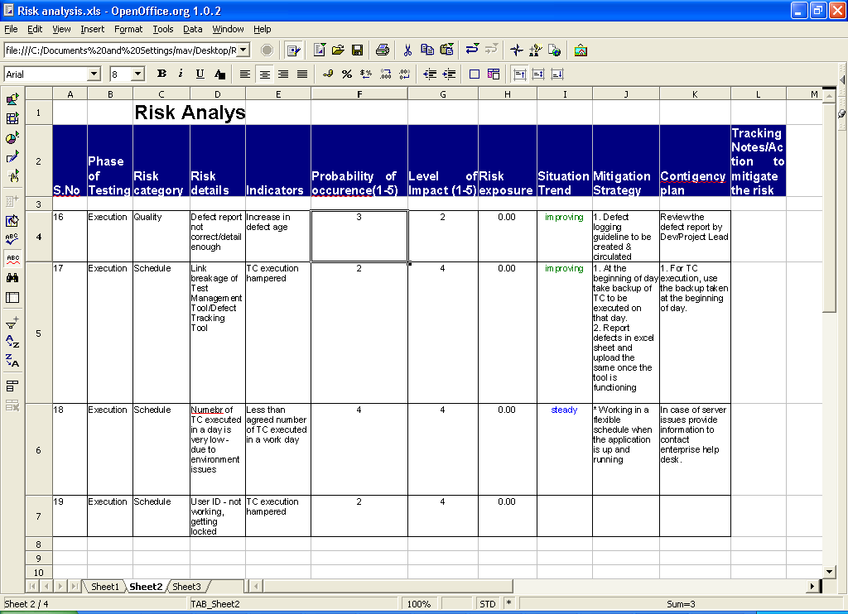
How much Testing Is Enough? (CONTD.)
Sample Risk Assessment Template
Notes:
An example of a Risk Analysis Sheet. You will have to evolve a strategy to asses the risk involved and create a test plan to mitigate the risk keeping in mind the availability of all resources.
The risk analysis determines how much testing is enough.

Slide 15
What is Testing?
The process consisting of all life cycle activities, both static and dynamic, concerned with planning, preparation and evaluation of software products and related work products to determine that they satisfy specified requirements, to demonstrate that they are fit for purpose and to detect defects
The process of exercising software to verify that it satisfies specified requirements and to detect errors
The process of executing a program with the intent of finding errors

Slide 16
So What Does Testing Achieve?
Testing identifies faults, whose removal
Improves Software Quality
Reduces Risk
Facilitates compliance to Business / Industry / Legal / Regulatory requirements and standards
Notes:
Software quality – increases the software ‘s potential reliability.

Slide 17
Test Objectives
A test objective is simply a testing “goal”. It is a statement of what the test team or tester is expected to accomplish or validate during a specific testing activity
Focuses on key areas to validate based on Context and Requirement
Objectives can be
Finding defects
Gaining confidence about the level of quality
Providing information for decision making
Preventing defects

Slide 18
Test Objectives – Examples
Examples for objectives of testing in different lifecycle phases
Component, Integration, System Testing: Finding defects (to cause & identify as many defects as possible, to fix them early in the lifecycle)
Acceptance Testing: Gaining confidence about quality (to confirm that system works as expected, to confirm that it meets requirements)
Maintenance Testing: Impact analysis (to test that no new defects have been introduced with new changes)
Operational Testing: Assess system characteristics (to verify reliability, availability)
System Testing: Providing information for decision-making (for risk analysis)

Slide 19
Defining Requirement, Review & Code
Requirement: A condition or capability needed by a user to solve a problem or achieve an objective that must be met or possessed by a system or system component to satisfy a contract, standard, specification, or other formally imposed document
Review: An evaluation of a product or project status to ascertain discrepancies from planned results and to recommend improvements
Code: Computer instructions and data definitions expressed in a programming language or in a form output by an assembler, compiler or other translator

Slide 20
Defining Debugging, Test Basis and Test Case
Debugging: The process of finding, analyzing and removing the causes of failures in software
Test Basis: All documents from which the requirements of a component or system can be inferred. The documentation on which the test cases are based
Test case: A set of input values, execution preconditions, expected results developed for a particular objective, such as to exercise a particular program path or to verify compliance with a specific requirement
Notes:
Error: refers to difference between Actual Output and Expected Output. Errors occur because we are not perfect and, even if we were, we are working under constraints such as delivery deadlines.
Fault: is a condition that causes the software to fail to perform its required function. A fault, if encountered, may cause a failure, which is a deviation of the software from its expected delivery or service.

Slide 21
General Testing Principles

Slide 22
Principle 1 – Testing Shows Presence of Defects
Testing does not provide a zero defect software
A good test is one that has a high probability of finding an as-yet-undiscovered error
Testing systematically uncovers different classes of errors and does so with a minimum amount of time and effort
Testing uncovers defect and minimizes impact, however, it does not guarantee defect free software

Slide 23
Principle 2 – Exhaustive Testing is Impossible
Testing all combinations of inputs and preconditions is not feasible
As an alternative, risk analysis and prioritization are used to optimize testing efforts
Exhaustive Testing requires an enormous amount of resources and is therefore impractical
Notes:
Risk is defined as a potential loss. A factor that could result in future negative consequences; usually expressed as impact and likelihood.
Complete testing is impossible for several reasons:
We can’t test all the inputs to the program.
We can’t test all the combinations of inputs to the program.
We can’t test all the paths through the program.
We can’t test for all of the other potential failures, such as those caused by user interface design errors or incomplete requirements analyses.

Slide 24
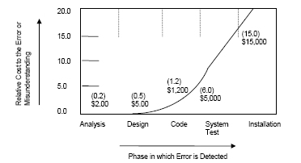
Principle 3 – Early Testing
Earlier the testing Lesser the cost
Notes:
20% of requirement defects cause 80 other defects in later Development stages
Peer reviews catch 60 percent of the defects.
Peer reviews, analysis tools, and testing catch different classes of defects at different points in the
development cycle.
Finding and fixing a software problem after delivery is often 100 times more expensive than finding and fixing it during the requirements and design phase.
The cost of fixing a defect includes Failure cost, Appraisal cost , Prevention cost and Production cost

Slide 25
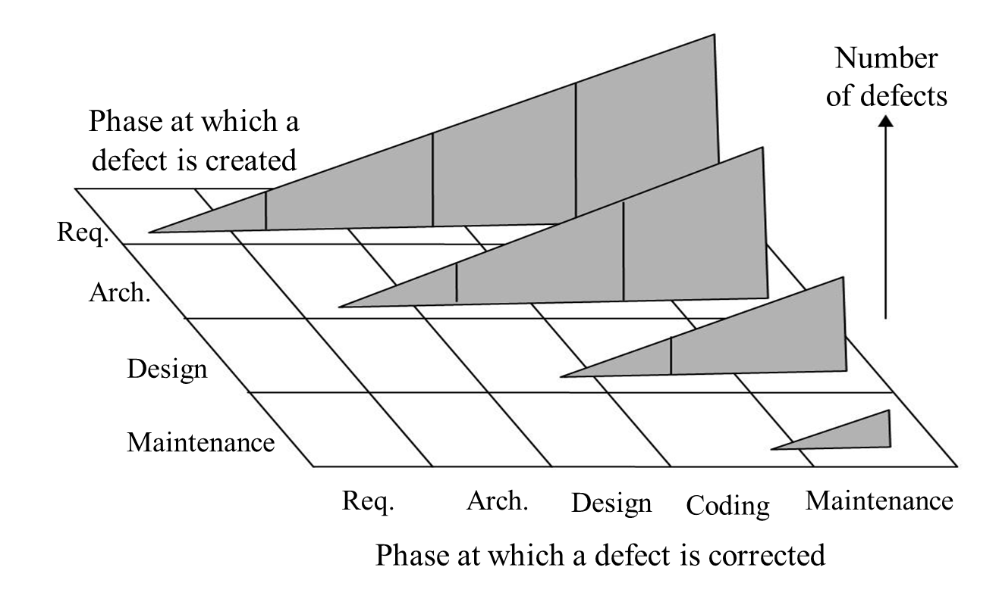
Principle 3 – Early Testing (CONTD.)
Earlier the testing Lesser the cost

Slide 26
Principle 4 – Defect Clustering
Number of defects vs. Modules – Small number of modules contributing to high ratio of defects
The probability of the existence of more errors in a section of a program is proportional to the number of errors already found in that section
Notes:
About 80 percent of the defects come
from 20 percent of the modules, and
about half the modules are defect free.
Defect Clustering: A small number of modules contain most of the defects discovered during pre-release testing, or show the most operational failures.
"Myers' Law" states,
"The probability of the existence of more errors in a section of a program is
proportional to the number of errors already found in that section.”

Slide 27
Principle 5 – Pesticide Paradox
Pesticide paradox – More the tests applied to a software, the more immune it becomes to it
There is very less chance of detecting new defects by running the same tests several times on a software
To overcome this paradox, testers should regularly review and revise existing tests to potentially find more defects
Notes:
The test cases need to be regularly reviewed and revised, and new and different tests need to be written to exercise different parts of the Software based on objective
Usability Test VS Functional Test

Slide 28
Principle 6 – Testing is Context Dependent
Test Effort, Impact and Priority varies depending on the following contexts:
Associated risk and prioritization of testing
Level of impact of a failure
Extent to which a software needs testing
Application | Test Effort | Risk | Impact | Priority
Aerospace applications | Maximum | Higher Risk | Critical | High
E-Commerce | Minimal | Lower Risk | Low | Medium
Notes:
Ranking Criteria can be based on
Severity
Probability
Visibility of failure
The importance of the requirements to be tested
What the customer wants
Change proneness
Error-proneness
Business criticality
Technical criticality and complexity

Slide 29
Principle 7 – Absence-of-errors Fallacy
Testing will not help if the system built is unusable and does not meet the requirements
Testing only exposes the presence of errors in software, it cannot be used to verify the absence of errors
Notes:
The test cases need to be regularly reviewed and revised, and new and different tests need to be written to exercise different parts of the Software based on objective
Usability Test VS Functional Test

Slide 30
Fundamental Test Process

Slide 31
Fundamental Test Process
Baseline Documents
Test Planning And Control
Test Strategy,
Testing Framework
Test Analysis And Design
Test Design Documents, Test Data
Test Implementation And Execution
Activity and Defect Report
Exit Criteria And Reporting
Test Closure
Final Report

Slide 32
Test Planning & Control
During Test planning identify
Test Assignment Pre-requisites
What is the Coverage criteria?
What is the Closure/Completion criteria?
Test Objective
What is aim of the activity?
Test process description
The testing process to be followed

Slide 33
Test Planning & Control (CONTD.)
The planning document should define / describe
Project objectives and background
Define the Test Plan objectives
Give a short system description
Note any outstanding issues, assumptions, known risks & contingencies
Test scope
Features to be tested and not to be tested
Test methodologies
Test phases
Identify definitions, participants, data sources, entry and exit criteria, requirements and work products
Techniques to be used
Notes:
Identify Why testing, what are we looking for, what is the end goal of the Testing assignment.
As the objective of a test should be to detect faults, a 'successful' test is one that does detect a fault. This is counter-intuitive, because faults delay progress A successful test is one that may cause delay. The successful test reveals a fault which, if found later, may be many times more costly to correct.
Once these Prerequisites are clearly identified we are in a position to set the Fundamental test Process to be adopted to achieve the desired objectives.
Coverage Criteria
Define what needs to be tested what not.
Define what is the extent of testing involved
Define what to look for and what not to.
These are defined in terms of items that are exercised by test suites,
branches,
user requirements,
most frequently used transactions, etc.
Depending on the type of testing the baseline and metrics that determine coverage will differ
Some examples of Coverage criteria include;
Usage intensity
Business importance
Exit Criteria
When do you stop. AT what stage will you say this is enough and get onto the next Test case.
Exit Criteria is a predefined set of conditions used as a Process Control mechanism, to verify that a Process or sub-process has been completed and that its products are of acceptable Quality.
Criteria could be
In this context it is used to determine when testing (at any test stage) is complete. These criteria may be defined in terms of cost, time, faults found or coverage criteria.
Minimum number / percentage of test cases successfully executed.
Certain type / risk categories to be comprehensively covered
Completed by a specified date
Defect density (defects per 100 conditions) falls below a pre-specified number

Slide 34
Test Planning & Control (CONTD.)
Test Controls emphasizes
Measuring and analyzing results
Defining metrics for measurement
Measuring specific work task completed vs. Planned
Analysis of measured metrics
Monitoring and Documenting Progress
Monitoring measures on weekly or daily basis
Document the progress and publish reports
Corrective Decision Making
Analysis of status on measured metrics
Conclude decision based on analysis results
Initiate Corrective Measures
Notes:
Identify Why testing, what are we looking for, what is the end goal of the Testing assignment.
As the objective of a test should be to detect faults, a 'successful' test is one that does detect a fault. This is counter-intuitive, because faults delay progress A successful test is one that may cause delay. The successful test reveals a fault which, if found later, may be many times more costly to correct.
Once these Prerequisites are clearly identified we are in a position to set the Fundamental test Process to be adopted to achieve the desired objectives.
Coverage Criteria
Define what needs to be tested what not.
Define what is the extent of testing involved
Define what to look for and what not to.
These are defined in terms of items that are exercised by test suites,
branches,
user requirements,
most frequently used transactions, etc.
Depending on the type of testing the baseline and metrics that determine coverage will differ
Some examples of Coverage criteria include;
Usage intensity
Business importance
Exit Criteria
When do you stop. AT what stage will you say this is enough and get onto the next Test case.
Exit Criteria is a predefined set of conditions used as a Process Control mechanism, to verify that a Process or sub-process has been completed and that its products are of acceptable Quality.
Criteria could be
In this context it is used to determine when testing (at any test stage) is complete. These criteria may be defined in terms of cost, time, faults found or coverage criteria.
Minimum number / percentage of test cases successfully executed.
Certain type / risk categories to be comprehensively covered
Completed by a specified date
Defect density (defects per 100 conditions) falls below a pre-specified number

Slide 35
Test Analysis & Design
Test Analysis & Design: Activity where testing objectives are transformed into test conditions and cases
Involves the following major tasks:
Reviewing the test basis (such as requirements, architecture, design, interfaces)
Identifying test conditions or test requirements and required test data based on analysis of test items, the specification, behavior & structure
Designing the tests
Evaluating testability of the requirements and system
Designing the test environment set-up and identifying required infrastructure and tools
Creating bi-directional traceability between test basis and test cases
Notes:
Aim
A concise statement of the intention of the particular test being made.
Test Data
A list of the test data to be input to the program.
If the program is interactive then the test data should specify a list of inputs from the user.
Expected Result
This shows what the program is expected to produce as a result of testing with the specified data.
This may be in the form of a screen layout or sample document.
Actual Result
These are the results produced when the test data is applied to the program.
During the testing stage, the actual results produced by the program are compared to the expected results.

Slide 36
Test Implementation & Execution
Activity where Test Conditions are transformed into test cases & test-ware, and the environment is set up
Major activities include:
Prioritizing test cases and creating test data
Verifying that the test environment has been set up correctly
Creating test suites from the test procedures for efficient test execution
Verifying & updating bi-directional traceability between test basis & test cases
Executing test cases manually or using automation as per plan
Comparing test execution outcome with expected outcome
Logging of defects found due to mismatch in the expected & actual outcome
Root cause analysis for incidents identified
Reporting incidents to stakeholders
Repeating test activities for discrepancies fixed

Slide 37
Evaluating Exit Criteria & Reporting
It is a process where a testing activity is assessed against the defined objectives
Evaluation of Exit Criteria involves:
Checking test logs against the exit criteria specified in test planning
Assessing if more tests are needed or if the exit criteria specified should change
Writing a test summary report for stakeholders
If exit criteria are not met, the earliest test activity that must be repeated in order to meet the criteria, is identified
Gaps should be identified and the test process should be restarted from that point
Notes:
As the objective of a test should be to detect faults, a 'successful' test is one that does detect a fault. This is counter-intuitive, because faults delay progress: a successful test is one that may cause delay. The successful test reveals a fault which, if found later, may be many times more costly to correct so, in the long run, is a good thing.
Completion/Exit/Coverage Criteria
Completion or exit criteria are used to determine when testing (at any test stage) is complete. These criteria may be defined in terms of cost, time, faults found or coverage criteria. Coverage criteria are defined in terms of items that are exercised by test suites, such as branches, user requirements, most frequently used transactions, etc

Slide 38
Test Closure Activities
It is an activity that collects data from completed test activities to consolidate experience, testware, facts & numbers
Major activities of Test closure involve:
Checking which deliverables have been delivered
Closure of incident reports or raising change records for those remain open
Documentation of the acceptance of the system
Analyzing lessons learnt for future releases and projects
Suggestions for improvement of test maturity
Notes:
Discrepancies identified need to be analysed in order to establish whether its cause lies in the system or in the test specifications design. It will help in deciding if the earliest test activity should be repeated or not, or do you have to initiate steps to report to fix the fault in the system.

Slide 39
Psychology of Testing

Slide 40
Psychology of Testing
Testing to find faults
Tester Developer Relationship
Independent Testing
Notes:
This section will deal more or less with the Human aspect involved in Software Testing.

Slide 41
Testing To Find Faults
Testing is performed with the primary intent of finding faults in the software, rather than of proving correctness
Testing can therefore be perceived as a destructive process
The mindset required to be a tester is different from that of a developer
Notes:
Basically a good tester needs to be,
Creative, Innovative, Inquisitive, Investigating bent of mind, and Always wanting to know what if.

Slide 42
Tester Developer Relationship
There are right and wrong ways of presenting faults to authors or management
During testing it is important to communicate
Changes happening to the application or menu structures that might affect the testing
Where the developer thinks the code might be buggy
Where there might be difficulty in reproducing reported bugs
Therefore, the need for ‘Constructive Criticism’
and ‘Collaborative Approach’
Notes:
The Tester and Developer relationship always needs to be friendly, as it is mutually beneficial.
It is always difficult to communicate faults of others and expecting them to accept it without ill feelings. Hence the tester needs to know that the developer take a lot of effort in designing and coding an application utilizing a lot of time and effort.
Both the Developer and the tester needs to know that they are both important entities in the SDLC. And working together is the only way forward.
Tester needs to demonstrate the following skills to put forth the errors discovered to receive an constructive and good feedback and action.
Empathy
Respect
Concreteness
Confrontation
Self disclosure and Diplomacy.
A tester needs to demonstrate that he has indeed followed the Test Case and the specifications to carry out testing and not based on some arbitrary actions.

Slide 43
Independent Testing
Test cases are designed by the person (s) who writes the software under test
Test cases are designed by another person (s)
Test cases are designed by a person (s) from a different section
Test cases are designed by a person (s) from a different organisation
Test cases are not chosen by a person (s)

Slide 44
Independent Testing – Why?
Developer led testing can miss problems
Testing often only covers circumstances that the development team has already allowed for in design
Tests demonstrate that the system does what developers intended, but not necessarily what the users need
Technical independence
Avoids duplicating assumptions
Covers a wider variety of use
Better represents user’s perspective
Technical Independence
Leveraged fully when accountability rests with a third-party
Testing invested in an organization separate from the development and project management organization. Testing team independently selects segments of software to analyze and test
Control of testing budget needs to be vested in an organization independent of the development organization to ensure that testing gets the focus it deserves
Managerial Independence
Financial Independence

Slide 45
Independent Testing – Benefits
Trained and experienced testers with objective of only testing
Structured processes and techniques
Unbiased way of looking for failures in a system
Curiosity, professional pessimistic approach, a critical eye, attention to detail
More insightful defect analysis
Notes:
These are the contents of this presentation.

Slide 46
Codes of Ethics

Slide 47
Code of Ethics
Codes of Ethics is incorporated in the organization to ensure that the information is not put into inappropriate use
Following are the codes of ethics:
Public: Consistent act with regard to the public interest
Client and Employer: To be at the best interest of the client and the employer
Product: To ensure that the deliverables provided meets the professional standard
Judgment: To maintain integrity and independence in the professional judgment
Management: To promote an ethical approach in the management level of testing
Profession: To bring forth the integrity and reputation of the profession in consistent with the public interest
Colleagues: Supportive and promote cooperation
Self: On Going learning of the practices in the profession & promote the practices

Slide 48
Review Questions
What is testing?
Why is it necessary?
What are the general testing principles?
Discuss about the code of ethics

Slide 49
Summary / Recap of Main Points
Why is testing necessary
What is testing
General testing principles
Fundamental test process
The psychology of testing
Codes of Ethics

Slide 50
What To Expect Next Week
In Class
Preparation for Class
Prepare testing manual for the RMI application
Propose a testing for the implemented application
Preparation of testing manual

